Slide 1
Section 3.3 Line Graphs

Slide 2
Line Graph
Line graphs are used to display paired data. Lines may use time intervals on the horizontal axis. These intervals may be categorical such as months of the year or numerical such as year
Line graph may allow us to see a trend or change over time more easily than a bar graph.

Slide 3
Example 1
Make a line graph from the given data.
Month | Rainfall in inches.
January | 1.2
February | 1.0
March | 2.7
April | 3.1
May | 2.5
June | 1.6
July | 1.2
August | 1.1
September | 2.1
October | 1.7
November | 2.5
December | 2.3

Slide 4
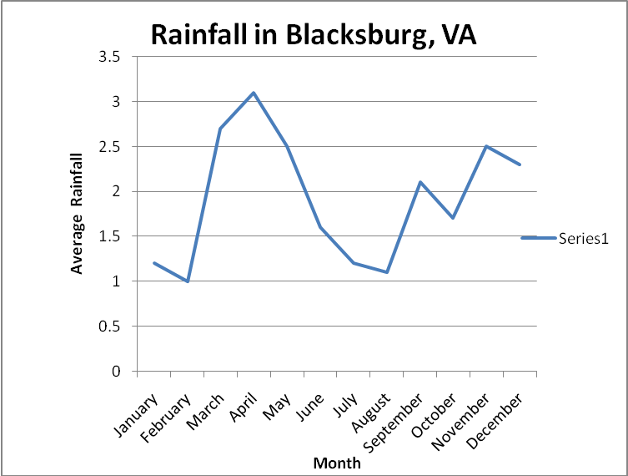
Solution to Example 1
Solution: The month of the year is categorical, so it should be displayed on the horizontal axis which leaves rainfall in inches on the vertical axis. The rainfall varies from 1.1 inches to 3.1 inches, we can scale the vertical axis from 0 inches to 3.5 inches.

Slide 5
Example 2
Make a line graph using the following information.
Quarter | Profits
1st | $450,000
2nd | $345,000
3rd | $620,000
4th | $515,000

Slide 6
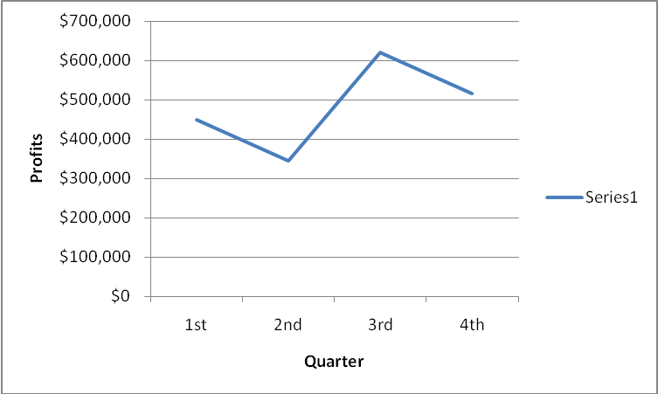
Solution to Example 2
Make a line graph

Slide 7
Example 3
Make a double line graph of data below:
Year | Blacksburg | Christiansburg
1970 | 10,000 | 13,000
1980 | 21,000 | 14,000
1990 | 30,000 | 14,000
2000 | 38,000 | 16,000

Slide 8
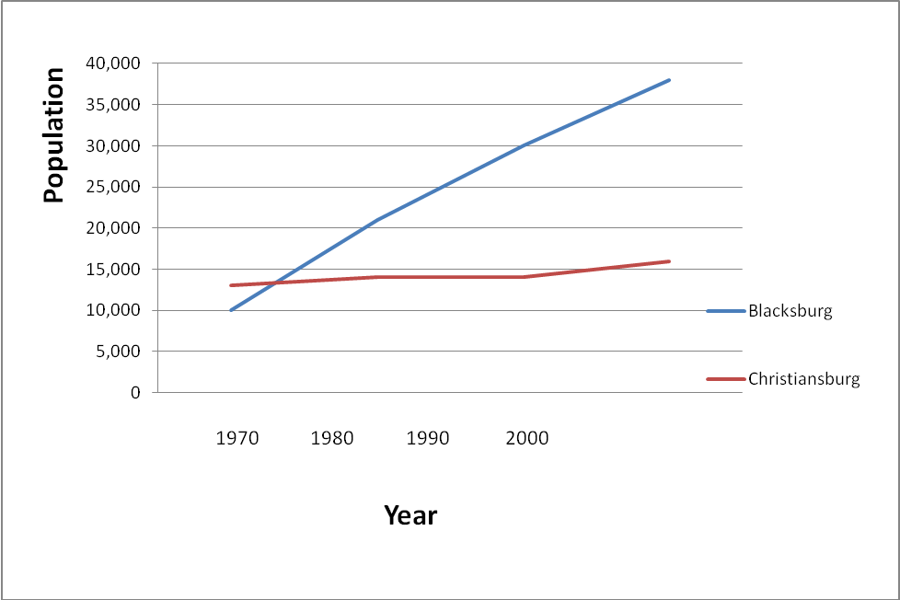
Solution to Example 3
Make a double line graph

Slide 9
Bar Graphs and Circle Graphs

Slide 10
Bar Graphs and Circle Graphs
Histograms provide a useful visual display of the distribution of data. However, the data must be quantitative.
In this section, we examine other types of graphs, some of which are suitable for qualitative data as well.
Let’s start with bar graphs. Bar graphs can be used to display quantitative or qualitative data.

Slide 11
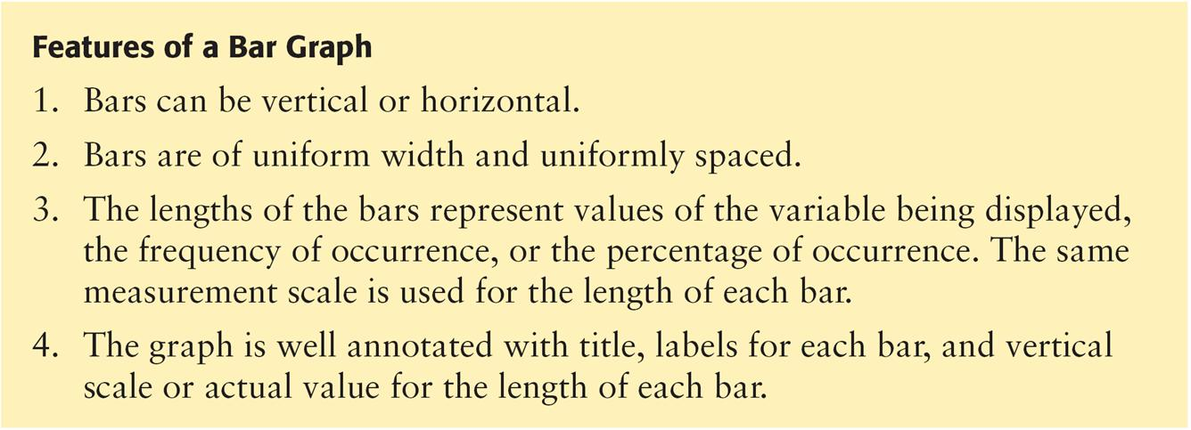
Bar Graphs and Circle Graphs

Slide 12
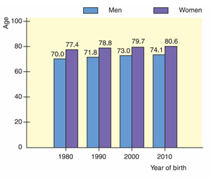
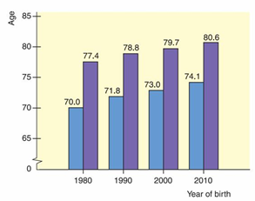
Example 1 – Bar Graph
Figure 2-11 shows two bar graphs depicting the life expectancies for men and women born in the designated year.
The graphs are called clustered bar graphs because there are two bars for each year of birth.
One bar represents the life expectancy for men, and the other represents the life expectancy for women. The height of each bar represents the life expectancy (in years).
Life Expectancy
Figure 2-11

Slide 13
Bar Graphs
An important feature illustrated in Figure 2-11(b) is that of a changing scale. Notice that the scale between 0 and 65 is compressed.
The changing scale amplifies the apparent difference between life spans for men and women, as well as the increase in life spans from those born in 1980 to the projected span of those born in 2010.
2-11(a)
2-11(b)

Slide 14
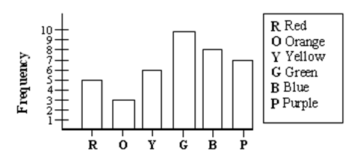
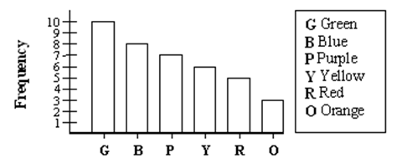
Bar Graphs and Pareto Charts
Example:
Bar Graph
Pareto Chart

Slide 15
Practice Problem 1: Draw a Bar Graph and a Pareto Chart
A fitness club keeps a record of their clients’ information about how many times they come to the fitness center every month. The following table gives each person’s name and the times they show up to the fitness center per month.
Name | Frequency
Chris | 3
Jessica | 8
Tim | 13
Mike | 12
Peter | 7
Rose | 4
Number of times showing up to the fitness center per month
Bar Graph

Slide 16
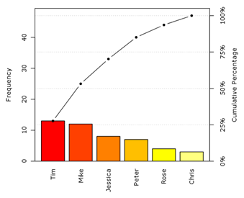
Practice Problem 1: Draw a Bar Graph and a Pareto Chart
Number of times showing up to the fitness center per month
Name | Frequency
Chris | 3
Jessica | 8
Tim | 13
Mike | 12
Peter | 7
Rose | 4
Pareto Chart

Slide 17
Circle Graph or Pie Chart
Another popular pictorial representation of data is the circle graph or pie chart.
Circle graph, ( or pie chart):
A circular shaped graph in which the wedge size of the circle visually displays proportional parts of the total population that share a common characteristic.
A circle graph is used to show the relationship of parts to a whole and to each other. Each pie-shaped wedge represents a fractional part of a whole.
The circle graph is very appropriate for qualitative data, or any data for which percentage of occurrence makes sense.

Slide 18
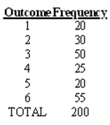
Example 2: Pie Chart
Toss a dice 200 times, here are the frequencies observed. Construct a circle graph/pie chart for the data in the table below.

Slide 19
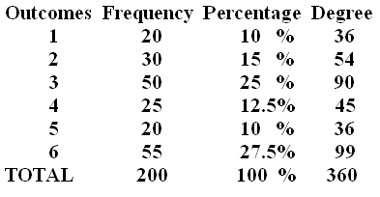
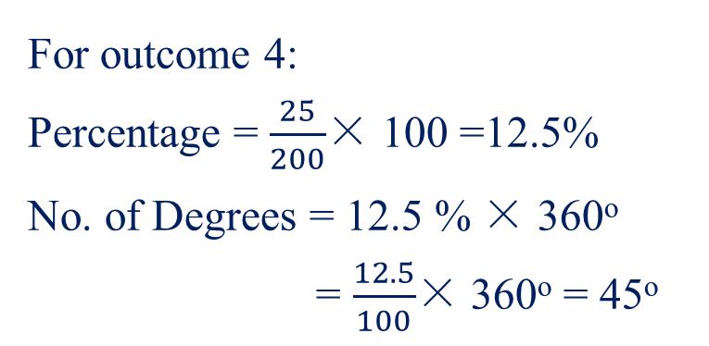
Example 2: Pie Chart
For outcome 4:
Percentage = $\frac{25}{200}$× 100 =12.5%
No. of Degrees = 12.5 % × 360º
= $\frac{12.5}{100}$× 360º = 45º
Calculating Percentages & Number of Degrees:
Percentage = $\frac{\text{Frequency}}{\text{Total} }$ × 100
No. of Degrees = $\frac{\text{Percentage}}{\text{100}}$ × 360º
Note：There are 360 degrees in a circle.

Slide 20
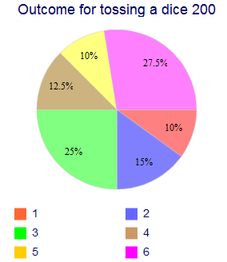
Example 2: Pie Chart
The total quantity, or 100%, is represented by the entire circle. Each wedge of the circle represents a component part of the total.
Circle graphs usually indicate the percentages of the various categories that are being graphed.

Slide 21
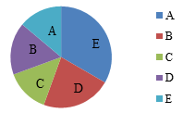
Practice problem #2:
Consider the following pie chart representing a sample of voter
preferences for five different choices in a referendum.
Which is the best estimate of the percentage of the population that supports choice "B"?
A. 10% B. 20% C. 30% D. 40%
Choice “B” accounts for about 20% of the whole. So the best estimate of the percentage of the population that supports choice “B’’ is 20%.

Slide 22
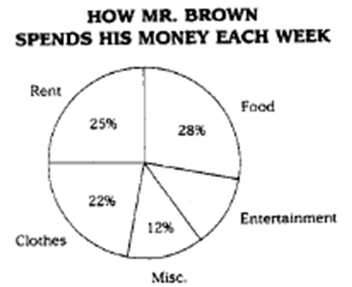
Practice problem #3:
Mr. Brown makes $350 a week. How much money does he spend on entertainment each week?
13%
A. $13.00 B. $42.00 C. $45.50 D. $87.50
350 * 13% = 350 * 0.13 = $45.50

